Slide 1
Paediatric Diabetes- Holistic approach in Management
Dr. Vipul Chavda
Dr Dhruvi Hasnani
Cardio- Metabolic Physician
Chairman, Rudraksha Multi Speciality Hospital, Bareja

Slide 2
BEFORE INSULIN
JL on 12/15/22 and 2 mos later
Before insulin was discovered in 1921, everyone with type 1 diabetes died within weeks to years of its onset
© 2004, John Walsh, P.A., C.D.E.

Slide 3
1923
Banting and Best Awarded Nobel Prize for Discovery And Use of Insulin in the Treatment of IDDM

Slide 4
TYPES OF DIABETES IN CHILDREN
Type 1 diabetes mellitus accounts for >90% of cases.
Type 2 diabetes is increasingly
recognized in children with presentation like in adults.
Permanent neonatal diabetes
Transient neonatal diabetes
Secondary diabetes e.g. in cystic fibrosis or Cushing syndrome.

Slide 5
EPIDEMIOLOGY TYPE 1 DM
–
Most common metabolic disease in childhood
Annual incidence 15 new cases per 100,000 in children < 18 yrs
Frequency increases with increasing age.
1: 1400 at age 5 yrs
1: 400 at age 16 yrs
Males and females equally affected
No correlation with socioeconomic status
–
–
–
–
–
–

Slide 6
“35% of the children and adolescents with T1D (<20years) come from the top 3 countries”
Diabetes in Children and Adolescents
Top 10 countries for number of children and adolescents with type 1 diabetes (<20 years), 2017
Ref: IDF Atlas 2017

Slide 7
Epidemiology of Type 1 Diabetes
Prevalence of diabetes in India is 8.31%
90–95% of diabetes: T2DM
5–10% of Diabetes: Juvenile diabetes
The incidence of Juvenile diabetes in India is 4.20 per 1,00,000 children under age group of 0–14 years
According to this comes to around 16665 new cases of juvenile diabetes every year

Slide 8
PROGRESSION TO TYPE 1 DM
Autoimmune markers (ICA, IAA, GAD
Autoimmune destruction
Honeymoon
100% Islet loss
“Diabetes threshold”

Slide 9
Syndromes
Wolfram syndrome
Down syndrome
Turner syndrome
Klinefelter syndrome
Wolcott–Rallison syndrome
Roger’s syndrome

Slide 10
Diseases of the exocrine pancreas
Pancreatitis
Neoplasia
Cystic fibrosis
Hemochromatosis
Fibrocalculous pancreatopathy
Pancreatic resection

Slide 11
TYPE 2 DM IN CHILDREN
Among 10 – 19 yr olds
T2 DM accounts for 33% of all new cases
African Americans – 42%
Caucasians – 10%

Slide 12
Obesity
Acanthosis Nigricans

Slide 13
NATURAL HISTORY OF TYPE 2 DIABETES
Genetic susceptibility
Environmental factors
Complications
Disability
Onset of diabetes
P
Insulin resistance R
E
besity
Ongoing hyperglycemia
Death
Risk for Disease
Metabolic Syndrome
Atherosclerosis ^{Retinopathy}
Blindness Renal failure CHD
Amputation
Hyperglycemia Hypertension
Nephropathy
Neuropathy

Slide 14
THERAPY OF T2 DM IN CHILDREN
Reduce calories – weight loss
NOT T1 DM diet with high complex CHO
No Between meal snacks
NOT T1 DM where hypoglycemia is frequent
Reduce CHO intake
Reduce fat intake
x
Exercise
increase healthy life style
Drug treatment early

Slide 15
Management of T2D in children Many adult T2D treatment options are not approved for use in children and adolescents
Adult therapy
Lifestyle management
Multiple medications available, including but not limited to:
Insulin sensitisers
Metformin*
TZDs - pioglitazone
Sulphonylurea
GLP-1 receptor agonists
DPP-4 inhibitors
SGLT-2 inhibitors
Insulin therapy
Paediatric T2D treatment options: ADA 2019
*Metformin is the only oral antihyperglycaemic agent approved for use in children with T2D GLP-1, glucagon-like peptide 1; DPP-4, dipeptidyl peptidase-4; SGLT-2, sodium-glucose co-transporter 2; T2D, type 2 diabetes; TZD, thiazolidinedione
ADA 2019 guidelines. Diabetes Care 2019;42(Suppl. 1):S148–S164; Reinehr T. World J Diabetes 2013;15:270‒281; Zeitler P et al. Pediatric Diabetes 2014:15 Suppl 20:26–46.

Slide 16
Children and adolescents with diabetes are different from adults with diabetes
Growth
Exercise and eating
Dependence on carers/parents
Diabetes care in school
Physiological and psychological burdens of adolescence
Fear of hypoglycaemia
Need to individualise the approach to treatment
Silverstein et al. Diabetes Med 2005;28:186–212
Notes:
Growth, variable exercise and eating patterns, dependence on parents and other care-givers for injections and blood tests, difficulties ensuring optimal diabetes care in schools, and the physiological and psychological burdens of adolescence
Fear of hypoglycaemia
The tremendous responsibility of care and fear of hypoglycaemia are extremely stressful for families
Parents struggle with the balance between the risk of long-term complications versus their fear of severe hypoglycaemia and the risk of neuropsychological complications
Both children and parents fear hypoglycaemia and the potential for hypoglycaemia to interfere with learning
Adolescence
Adolescence is a period of rapid biological change accompanied by increasing physical, cognitive, and emotional maturity
Adolescents are struggling to find their own identity separate from their families – diabetes care may interfere with the adolescent’s drive for independence and peer acceptance

Slide 17
Unique aspects in management of diabetes in children
Family dynamics
Different Developmental stages
Changes in insulin sensitivity with physical growth and sexual maturity
Neurological vulnerability to hypo and hyperglycemia
Unique aspects in children
Ability to provide self care
Possible adverse neurocognitive effects of Diabetic ketoacidosis
Due to the nature of clinical research in children, the recommendations are less likely to be based on clinical trial evidence.
ADA Standards of medical care in diabetes 2019

Slide 18
Holistic Management

Slide 19
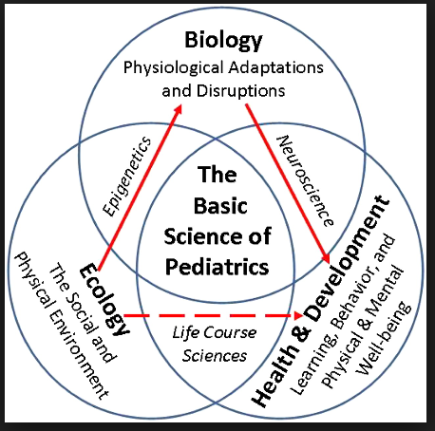
Care of Chronic diseases
Care of any chronic disease not only requires medical treatment but also information, education, counselling, and holistic support. It involves the whole ecosystem
Type 1 diabetes is no different

Slide 20
Management of type 1 diabetes
Need for Holistic Care

Slide 21
Principles and Goal of Care
Goals of care include:
Eradicate symptoms.
Prevention of acute complications
Hypoglycemia
Diabetic ketoacidosis
Optimum growth and pubertal development
Ensure good psycho-social adaptation and function
Prevention of long term complications
Notes:
The first principle is to set goals for the care of children with diabetes. The first goal is to eradicate symptoms. Adequate control of glucose values will usually mean that the presenting shall be abolished. Once this is done, it is important to prevent acute complications of diabetes. In the previous session, we discussed how to manage these acute emergencies but it is even more important to prevent these episodes. Good management of diabetes shall result in achieving the next goal of care, namely for the child to achieve optimal growth and pubertal development. As type 1 diabetes is a challenging condition to live with and to manage, ensuring good psycho-social adaptation and function is important for the successful long term management of diabetes. This would included acceptance of the diabetes and compliance with the dietary and medications regimens. In the long term, complications of diabetes are the greatest risks for children with diabetes. Meticulous management and control of diabetes is needed from diagnosis to prevent the long term complications of diabetes
21

Slide 22
These are main things which need to be kept in mind
Education Glycemic targets Insulin therapy Glucose monitoring Nutrition Hypoglycemia DKA | Individualization Smoking Sexual Health Psychology Comorbidities Complications Transition to Adult care

Slide 23
Improper growth and Vicious Cycle
Poor self esteem
Acute complications more
Chronic complications more
Associated diseases more
Higher costs
Higher mortality
More absenteeism, lower income
Lower employability
Lower income
Lower quality of life
Cost of care further increased
Causing or increasing indebtedness

Slide 24
What should one check?
Measure and plot at each clinic visit ( every 3 months)
Height
Weight
BP
Assessment of puberty annually
Calculate growth velocity
In a well controlled child, growth
should be normal for Mid Parental Height

Slide 25
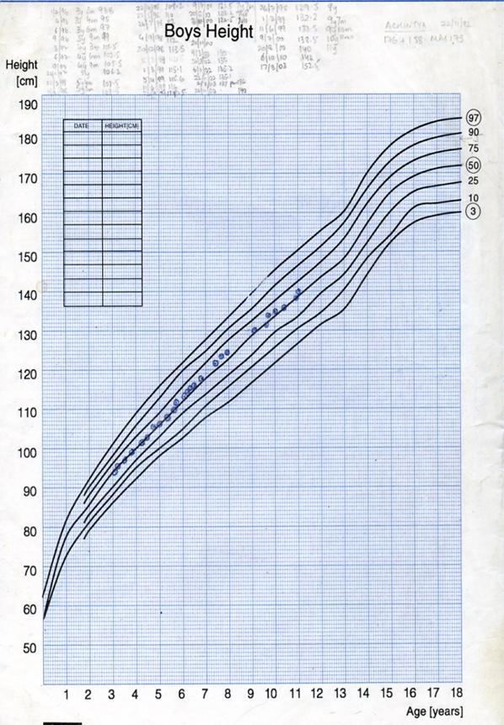
ISPAD Clinical Practice Consensus Guidelines 2018 Compendium
Monitoring of growth and physical development and the use of growth charts are essential in the continuous care of children and adolescents with type 1 diabetes and should be done on continuous basis

Slide 28
What can go wrong?
Poor height + weight gain
A1c: hypoinsulinization
Thyroid function (delayed BA)
Celiac workup
Renal function
Hemogram, SGPT
Psychosocial environment
Excess weight gain
Hyperinsulinization, high intake of fats & carbs
Over/ underweight
Eating disorders

Slide 29
Insulin requirement is age dependent
Insulin requirements* are usually based on body weight, age, and pubertal status.
Pre puberty 0.7 U/kg/day
Mid puberty 1 U/kg/day
Late Puberty 1.2 U/kg/day
*http://www.ncbi.nlm.nih.gov/pmc/articles/PMC3872685/ accessed on 15th Oct 2015
Notes:
left

Slide 30
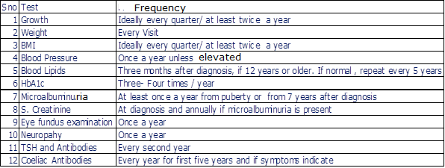
Screening* list should be known to adolescents
ISPAD GUIDELINES2013
Notes:
30

Slide 31
Every child with type 1 diabetes can grow into healthy adult
Notes:
Teddy Ryder was among the first 12 people to receive insulin in year 1922. He was then 5 years old and he lived till 1993 with more than 75 years of diabetes duration

Slide 32
Minimum things to be done in type1 DM
1. Taking Insulin
2. Self monitoring of blood glucose- SMBG
3. Regualar follow up to your doctor
4. Blood tests- HbA1c, S.Creatinine, TSH, Lipid Profile, microalbumin, urine- RM, etc
5. Fundus
6. Foot check up
7. cardiac assessment.
8. Checking Growth and development in kids and adolescents.

Slide 33
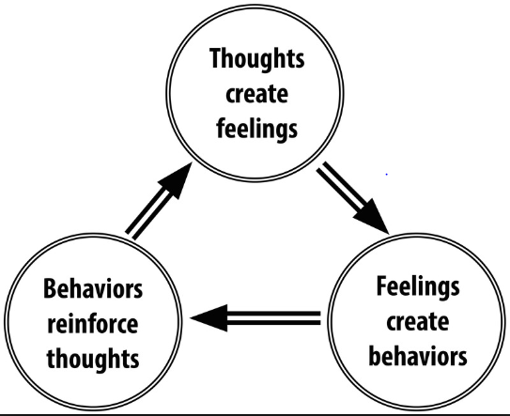
Conclusion
Best of diabetes education fails when it is not coupled by appropriate counselling and support.
Only counselling does not work till a person gets an appropriate support and diabetes education.
Best of support fails when it does not works on principals of diabetes education.

Slide 34
Paediatrician, Diabetologist Dietician, Nurse, Family,
Friends & Patient

Slide 36
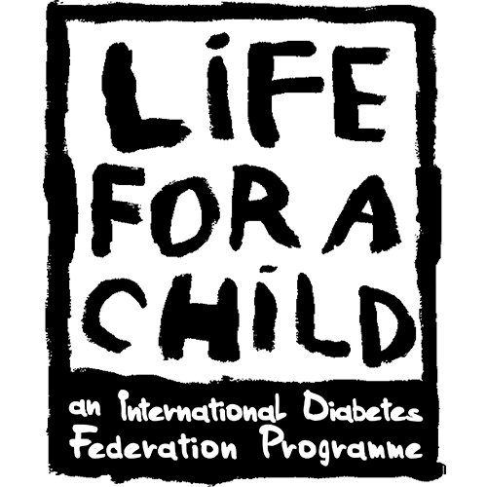
Providing affordable healthcare.. CDIC, LFAC and Diacare trust

Slide 37
CDIC- 449
LFAC – 347
Diacare Trust- 806
We would be glad to support any other center in help or need through our program in whichever way it is possible for us!

Slide 38
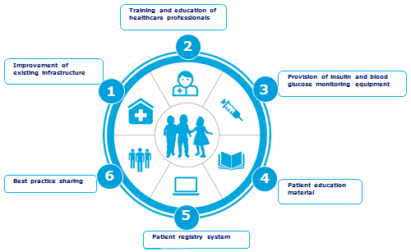

Slide 39
DCCT AND OTHER STUDIES
Research studies between 1970 and 2000 showed that complications could be prevented by lowering high glucose levels
Studies
DCCT 1984-1992
EDIC 1996
UKPDS 1978-1998
Kumamoto 1992-2000
Results
Better health
Fewer complications
Improved sense of well-being
More flexible lifestyle
© 2004, John Walsh, P.A., C.D.E.

Slide 40
EDUCATION
Educate child & care givers about:
Diabetes
Insulin
Life-saving skills
Recognition of Hypo & DKA
Meal plan
Sick- day management

Slide 41
MANAGEMENT
Principles of insulin therapy
Varies between individuals and changes over time
The correct dose of insulin is the dose that achieves the best glycemic control without causing obvious hypoglycemia problems and achieving normal growth(height and weight)
Dosage depends on,
Age, weight, stage of puberty, duration and phase of diabetes, state of injection sites, nutritional intake and distribution, exercise pattern, daily routine

Slide 42
Hyperglycemia: Microangiopathic complications
Hypoglycemia: Neuronal loss Poor school performance seizures

Slide 43
Thanks……!!!!!

Slide 44
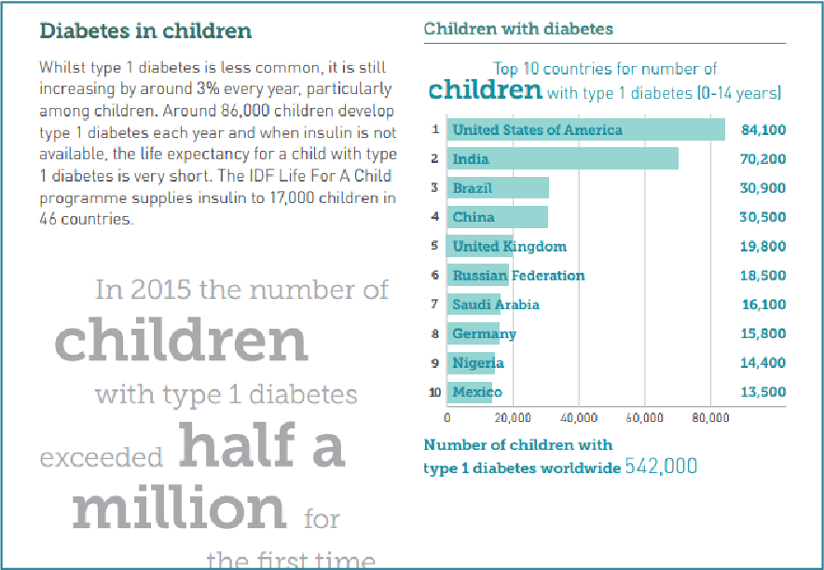
Ref: Diabetes in Children (IDF, 2015, p.16)

Slide 45
Epidemiology Continued
There is a lack of countrywide uniform data of type 1 Diabetes and that too with longitudinal follow up.
And whatsoever data is available shows discrepancies.
A lot of adult type 1 diabetic patients are not accounted for; why? Is this because we do not have the data or we do not have the patients (do they survive?)

Slide 47
All young diabetics are not type 1

