Slide 1
IMA HQs. Ethics & Medico-legal Knowledge Bank
National President – Dr.K.K.Aggarwal
National President
Elect – Dr.Ravi Wankhedkar
Honorary Secretary
General – Dr.R.N.Tandon
Coordinator – Dr.Dinesh Thakare

Slide 2
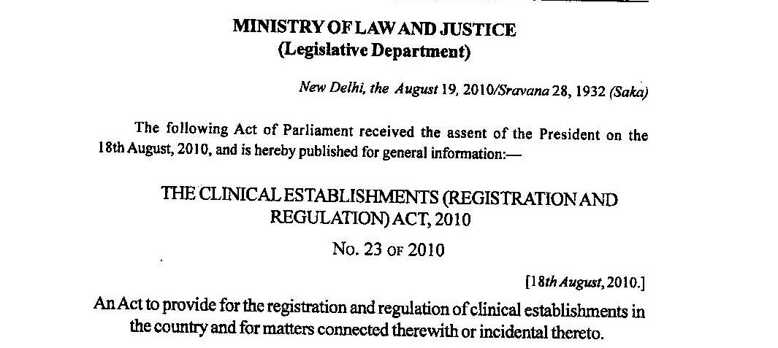
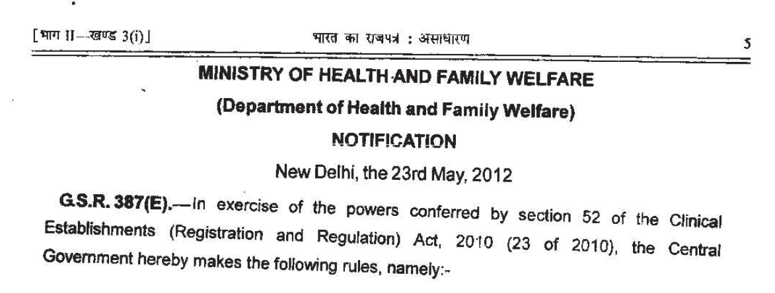
The Clinical Establishments (Registration and Regulation) Act 2010 and Rules 2012
Rules 2012
Act 2010

Slide 3
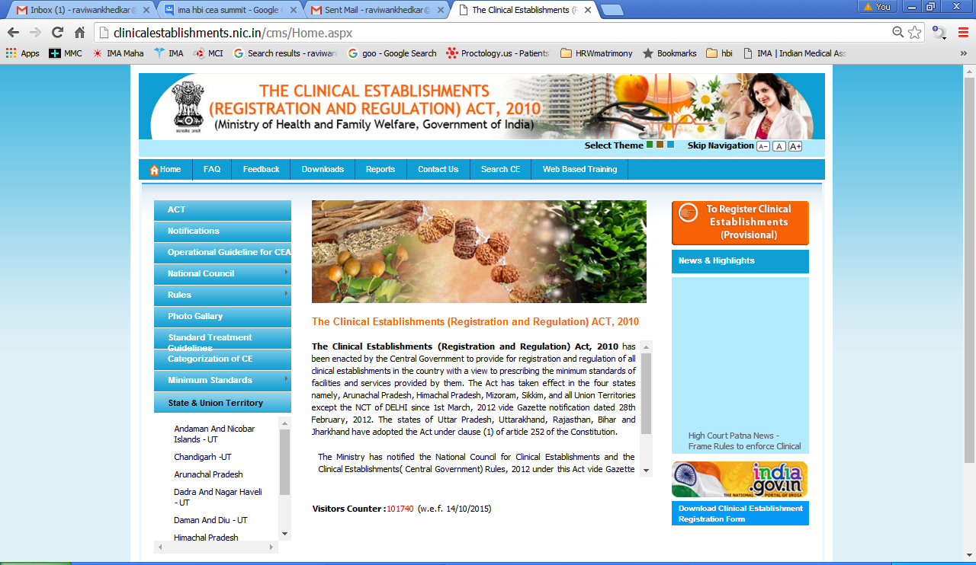

Slide 4
HISTORY
The Clinical Establishment Act (CEA) was first introduced in Parliament by then Health Minister Shri. Ambumani Ramadoss in 2007.
And was referred to the Parliamentary Committee headed by Shri. Amar Singhji

Slide 5
HISTORY
Parliamentary Committee rejected the said Bill citing reasons..

Slide 6
Parliamentary Committee Rejected The CEA 2007
1. Health is a State subject, so there is no need of Central Act. Most of the States are having their own Act.

Slide 7
Parliamentary Committee Rejected The CEA 2007
2. The requirement about health services differ from State to State, according to geo-socio-economic reasons.

Slide 8
Parliamentary Committee Rejected The CEA 2007
3. Bill will push the present health structures, including Govt. Hospitals, towards collapse

Slide 9
Parliamentary Committee Rejected The CEA 2007
4. Bill will directly increase the establishment cost, so directly escalating the treatment costs.
80 % people go for treatment to private hospitals.

Slide 10
Parliamentary Committee Rejected The CEA 2007
5. Broadly, in preparing the Act, ‘detail thought’ has not been given and the Indian scenario in health is not considered.

Slide 11
Parliamentary Committee Rejected The CEA 2007
6. Only few small States and few Union Territories have requested for Central Bill as they found themselves unable to pass their own State Act.

Slide 12
BUT
Exactly after the gap of 3 years, this rejected Bill was again introduced in Parliament by then Health Minister Hon’ble Shri. Gulam Nabi Azad in 2010

Slide 13
IRONY
CEA 2010 WAS PASSED IN BOTH THE HOUSES OF PARLIAMENT
WITHOUT
A SINGLE WORD OF
DISCUSSION ON IT.

Slide 14
Efforts Failed
IMA through its National Leaders tried hard to convince then Hon’ble Union Health Minister Shri. Gulam Nabi Azad. Unfortunately, he has not given any heed to IMA’s suggestions.

Slide 15
Objectives of the Act
The specific objectives are
i) To establish digital registry of Clinical Establishments at National, State and District level.
ii) To prevent quackery by unqualified practitioners by introducing registration system, which is mandatory.

Slide 16
Objectives of the Act
iii) To prescribe minimum standards of facilities and services for all categories of health care establishments (except teaching hospitals, health care) and ensure compliance of other conditions for registration like standards treatment protocols, display of range of rates to be charged, maintenance of records.

Slide 17
Who is included ?
A clinical establishment
owned, controlled or managed by-
The Government or a department of the Government;
A trust, whether public or private;
A corporation (including a society) registered under a Central, Provincial or State Act, whether or not owned by the Government;
A local authority; and
A single doctor

Slide 18
Who is excluded?
does not include the clinical establishments owned, controlled or managed by the Armed Forces

Slide 19
The National Council for Clinical Establishments
There shall be established for the purposes of this act, a council to be called the National Council for clinical establishments.
Chair person:
Director-General of Health Service, Ministry of Health and Family Welfare
Secretary: Joint Secretary MOH GOI

Slide 20
The National Council’s functions
Compile and publish a National Register of clinical establishments within two years from the date of the commencement of this act;
Classify the clinical establishments into different categories;
Develop the minimum standards and their periodic review;

Slide 21
The National Councils functions
Determine within a period of two years from its establishment, the first set of standards for ensuring proper healthcare by the clinical establishments;
Collect the statistics in respect of clinical establishments;
Perform any other function determined by the Central Government from time to time.

Slide 22
State council for clinical establishments
Every state government shall constitute a state
council for clinical establishments.
Chairman - Secretary Health, ex officio post;
Secretary - Director of Health Services, ex officio post

Slide 23
State council functions
Compiling and updating the State Registers of clinical establishment;
Sending monthly returns for updating the National Register;
Representing the State in the National Council;
Hearing of appeals against the orders of the authority; and
Publication on annual basis a report on the state of implementation of standards within their respective states.

Slide 24
District registering authority
The state government shall, set-up
District Registering Authority.
District Collector - Chairperson
District Health Officer – Convener
3 members
From Police
Senior level officer of the Local Self Government at District Level
From Professional association

Slide 25
District Registering Authority functions
The District registering authority shall be
responsible for
Grant, renewal, suspension or cancellation of registration
Enforcing compliance
Investigation of complaints
Preparation and submission of report
The District Health Officer / Chief Medical Officer
shall exercise the powers of the district health
authority

Slide 26
The Process Of Registration
Provisional registration within 10 days
Inspection
Compilation Of Standards for Permanent registration
Permanent registration
The certificate shall be valid for a period of five years from the date of issue.

Slide 27
Provisional Certificate
After the commencement of the act,
we have to apply within
6 Months for new establishments
12 Months for existing establishments
Apply by post or in person or online.
Within 10 Days, DHO / CMO will issue the provisional certificate
No inquiry prior to grant of provisional registration
Validity of provisional registration - 1 year
In the event of change of category or location or ceasing of function, the establishment has to surrender its certificate & apply afresh

Slide 28
Provisional Certificate

Slide 29
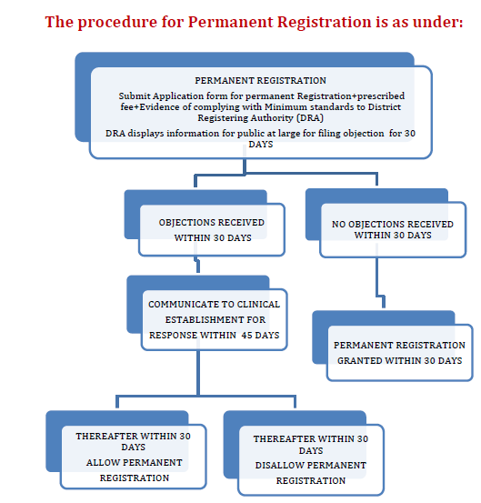

Slide 30
Conditions For Registration & Continuance
Every clinical establishment shall fulfill the
following conditions, namely :-
The minimum standards of facilities and services as may be prescribed;
The minimum requirement of personnel as may be prescribed;
Provisions for maintenance of records and reporting as may be prescribed;
Such other conditions as may be prescribed.

Slide 31
Mandatory Clause
The clinical establishment shall undertake to provide, within the staff and facilities available, such medical examination and treatment as may be required to stabilise the emergency medical condition of any individual who comes or is brought to such clinical establishment.

Slide 32
RULES
Monetary penalty
for non-registration
Disobedience of order, obstruction and refusal of information
Every clinical establishment shall, furnish such returns or the statistics and other information in such manner, as may be prescribed

Slide 33
RULES
shall maintain medical records of patients treated by it and health information and statistics in respect of national programmes and furnish the same to the district authorities in form of quarterly reports.

Slide 34
RULES
copies of all records and statistics shall be kept with the clinical establishment concerned for at least 3 or 5 years.
shall comply with the Standard Treatment Guidelines and maintain electronic medical records of every patient as may be notified by the Central Government from time to time.

Slide 35
RULES
shall charge the rates for each type of procedure and service within the range of rates to be notified by the central government from time to time, for such procedures and services.
shall display the rates charged for each type of service provided and facilities available, for the benefit of the patients at a prominent place in the local dialect and as well as in English language.

Slide 36
RULES
shall establish mechanisms for review and audit for the purpose of provision of rational practice and service.
shall carry out every prescription audits every 3 months.

Slide 37
National Scenario At Present
States in which CEA 2010 has become applicable (Chapter I, Clause 1(3))-
Six Union Territories except Delhi; states of Himachal Pradesh, Mizoram, Arunachal Pradesh & Sikkim because of their prior resolution passed in their assembly accepting the Central Regulation.

Slide 38
National Scenario At Present
States in which CEA 2010 has become applicable by their adoption in their State Assemblies- Assam, Bihar, Jharkhand, Uttar Pradesh, Uttarakhand, Rajasthan.

Slide 39
National Scenario At Present
States which have their own Act listed in schedule to CEA and exempt from CE Act. They may repeal their own Act before adopting the CEA 2010 –
West Bengal, Maharashtra, Andhra Pradesh, Odisha, Delhi, Manipur, Nagaland, Madhya Pradesh, Punjab (not operationalized)

Slide 40
National Scenario At Present
Other States which had enacted their own Acts -
Jammu and Kashmir, Karnataka, Chhattisgarh, Tamil Nadu (not implemented).

Slide 41
Harmful Effects Of CEA
Stabilization of patient’s health in
Emergency (Chapter I, Clause 2 (d),(o))
(Chapter III, Clause 12 (2))
Any patient brought to hospital must be attended. The patient must be ‘stabilized’ before referring to another hospital.
Doctor will be responsible if patient’s condition deteriorates during transit.

Slide 42
Stabilization of patient’s health in emergency
Every doctor will have to add a casualty department to his present clinical establishment if stabilization clause is included.
Who will pay for stabilization??

Slide 43
Stabilization of patient’s health in emergency
IMA’s View :-
Every Doctor Looks After the Emergency Patient to His Own Capacity and His Clinical Establishment.

Slide 44
Stabilization of patient’s health in emergency
IMA’s View :-
Including This ‘Stabilization Clause’ in the Frame of Law will Spoil Patient – Doctor Relationship.

Slide 45
Stabilization of patient’s health in emergency
IMA’s View :--
‘Stabilization’ Clause Must Be Removed.
Doctors Will Give First Aid And Refer the Patient With Due Care.

Slide 46
Harmful Effects Of CEA
The National Council Will Have Only One Representative Of IMA
(Chapter II, Clause 3 (2) (c), (e), (k))
However, systems of Indian Medicine including YOGA, SIDDHA and UNANI will have four representatives on the said council.

Slide 47
Harmful Effects Of CEA
The State Councils Will Have Only One Representative Of IMA
(Chapter III, Clause 8 (2) (e), (f))
However, systems of Indian Medicine including YOGA, SIDDHA and UNANI will have three representatives on the said council.

Slide 48
Only One Representative Of IMA
Thus, more than 80% of health service professionals providing modern medicine facilities all over the country will be guided by representatives of associations who have no knowledge of modern medicine or by consumer activists.

Slide 49
Only One Representative Of IMA
IMA’s View:-
Indian Medical Association and the representatives of allopathic private practitioners shall be given more representation.

Slide 50
Only One Representative Of IMA
IMA’s View:-
IMA shall be taken into confidence for framing of standards of clinical establishment and number of professionals and paramedical personnel and their qualifications for different categories of clinical establishment for different geographical areas.

Slide 51
Harmful Effects Of CEA
District Registration Authority
(Chapter III, Clause 10 (1); Rule 8 (1))
Chairperson - District Collector
Convener - District Health Officer / Chief Medical Officer
3 members one each from-
1.City Police Commissioner/Senior SP/SP/his nominee
2.Senior level officers of the Local Self Government at District Level
3.Professional medical association
The District Health Officer / Chief Medical Officer shall exercise the powers of the district health authority

Slide 52
District Registration Authority
IMA’s View :-
District Registering Authority (DRA) must be headed by a medical person.
The police officer shall be excluded from the DRA.

Slide 53
District Registration Authority
IMA’s View :-
The three members of DRA shall include…
1.One representative of Indian Medical Association President or Secretary or his representative at district level.
2.One representative from a reputed NGO working in the field of health for minimum last 3 years.
3.Retired Deputy Director of Health Services / DHO / Medical Superintendent / Prof. of medical college.

Slide 54
District Registration Authority
The District Registration Authority will issue provisional registration certificate within 10 days with out any inquiry.
(Chapter IV, Clause 15, 16 (1);
Rule 8 (3) (a),(b),(c),(d))

Slide 55
Harmful Effects Of CEA
The License Raj….
On submission of evidence of compilation of prescribed minimum standards
And if authority is satisfied (??), it will issue permanent registration certificate for 5 years.
(Chapter IV, Clause 25, 28, 30)

Slide 56
The Licence Raj….
Application for renewal of registration shall be made within six months before the date of expiry of validity of the certificate.
(Chapter IV, Clause 30 (4))
All the procedure of registration will be repeated.

Slide 57
The Licence Raj….
IMA’s View :--
If inspection is not carried out within 30 days of submission of evidence of compilation of minimum standards, the certificate shall be automatically deemed permanent & hospital can start running for the period of 5 yrs.
This will reduce harassment by unnecessary delay done for the sake of bribe.

Slide 58
Harmful Effects Of CEA
The Authority will Invite Public Objections Before Granting Permanent Registration to any Clinical Establishment.
(Chapter IV, Clause 26)
Naturally, Permission of Neighbors will be Compulsory to Run the Hospital.

Slide 59
Public Objections
IMA’s View :--
May be used as a tool to harass the health professionals.
May promote blackmailing by anti-social elements.
Hence, Remove The Clause.

Slide 60
Harmful Effects Of CEA Inspection
The District Registration Authority Personnel Can Enter In To The Establishment For Inspection / Inquiry
(Chapter IV, Clause 33 (1))

Slide 61
Inspection

Slide 62
Power To Enter
Inspectors/ authorities can visit your clinic at any reasonable time for ensuring that you comply with all rules and regulations laid down. Thus in effect, even a SDM can threaten you with a fine of Rs. 5,00,000 on any pretext under Clause 42 (1) &( 2). This opens up unlimited avenues for undue extortion.

Slide 63
Power To Enter
If the District Registration Authority is satisfied that the establishment is not following provisions of the Act, it can cancel registration of the establishment.
(Chapter IV, Clause 32 (1))

Slide 64
Power To Enter
IMA’s View :-
Medical Establishment which has entry level accreditation or above under NABH, shall be registered automatically under CEA without any other formalities.
No inspections shall be required.

Slide 65
Harmful Effects Of CEA
Each category of clinical establishments shall charge the rates for each type of procedure and service within the range of rates to be notified by the central government from time to time, for such procedures and services.
(Rule 9 (ii))

Slide 66
Fixation Of Charges
IMA’s View :--
At the most, broad category of services provided and charges for different services and procedure may be displayed at a prominent place in clinical establishment and every user is informed well in advance about the expected cost of treatment in broad terms.

Slide 67
Harmful Effects Of CEA
To Ensure Compliance Of Standard Treatment ‘Guidelines’ (Rule 9 (iii))
Determined And Issued by Central / State Government
Significant deviation not allowed.
A doctor do not have absolute freedom
to change the treatment line depending
on his clinical assessment.
No respect to clinical acumen of the doctor

Slide 68
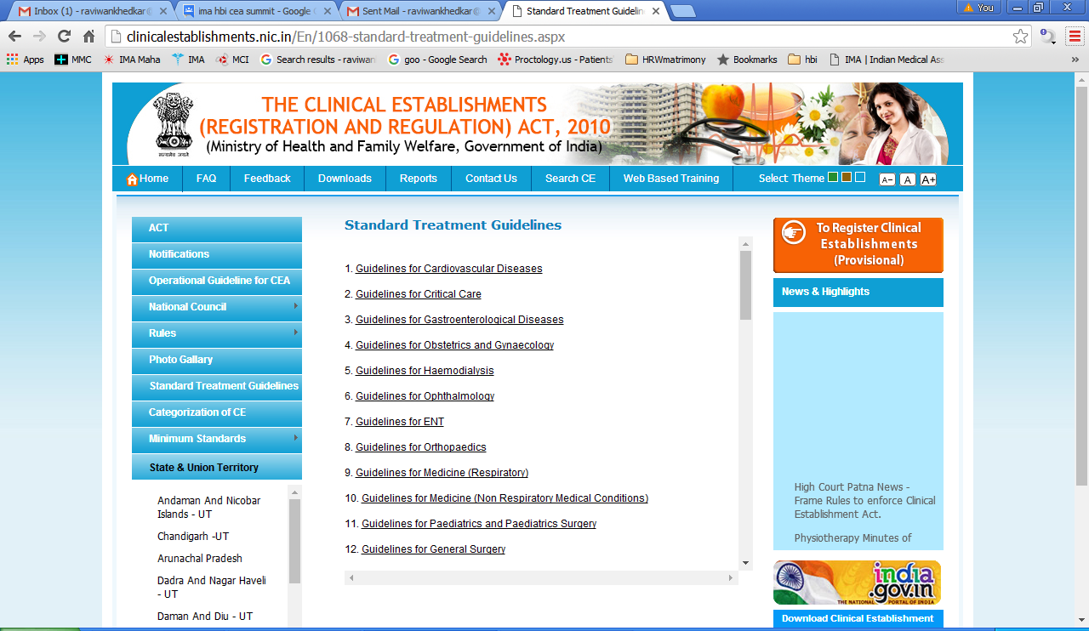

Slide 69
Compliance Of Standard Treatment ‘Guidelines’
IMA’s View:-
Standard Treatment Guidelines Shall Be Prepared By WHO, International & National Professional Associations, Not By The Government.
The Doctor Shall Be Free To Use His Own Expertise, Clinical Acumen & Experience While Treating The Particular Patient

Slide 70
Categorization of CE Level 1(A) & (B)
Level 1(A) and Level 1(B) Hospitals shall also include support systems required for the respective services like Pharmacy, Laboratory, etc.

Slide 71
Categorization of CE- Hospital Level 2 (Non-Teaching)
This level may include all the services provided at level 1(A) and 1(B) and services through other medical specialties given as under ,in addition to basic medical given under 1(B) like:
a. Orthopaedics
b. ENT
c. Ophthalmology
d. Dental
e. Emergency with or without ICU
f.Anaesthesia
g. Psychiatry
h. Skin
i.Pulmonary Medicine
j.Rehabilitation, etc.
And support systems required for the above services like Pharmacy, Laboratory, Imaging facilities, Operation Theatre etc.
Example: District Hospital, Corporate Hospitals, Referral Hospital, Regional/ State Hospital, Nursing Home and Private Hospital of similar scope etc.

Slide 72
Categorization of CE Hospital Level 3 (Non-Teaching) Super-specialty services
This level may include all the services provided at level 1(A), 1(B) and 2 and services of one or more of the super specialty with distinct departments and/or also Dentistry if available.
It will have other support systems required for services like pharmacy, Laboratory, and Imaging facility, Operation Theatre etc.
Example: Corporate Hospitals, Referral Hospital, Regional/State Hospital, Nursing Home and Private Hospital of similar scope etc.

Slide 73
Categorization of CE Hospital Level 4 (Teaching)
This level will include all the services provided at level 2 and may also have Level 3 facilities. It will however have the distinction of being teaching / training institution and it may or may not have super specialties. Tertiary healthcare services at this level can be provided through specialists and may be super specialists (if available).
It will have other support systems required for these services. It shall also include the requirement of MCI/other registering body for teaching hospitals and will be governed by their rules. However registration of teaching Hospitals will also be required under Clinical Establishment Act for purpose other than those covered under MCI such as, records maintenance and reporting of information and statistics, and compliance to range of rates for Medical and Surgical procedures, etc.

Slide 74
Specialty wise Standards
Standards are different for different specialties. If a husband and wife are of different specialties, they will have to follow two different sets of standards in the same hospital setup which will be cumbersome.
So, the provisions shall be relaxed and common set of standards shall be permitted.

Slide 75
Electronic Medical & Health Records; Statistics
Shall maintain medical records of patients treated by it and health information and
statistics in respect of national programs and furnish the same to the district authorities in form of quarterly reports.

Slide 76
Electronic Medical & Health Records; Statistics
Copies of all records and statistics shall be kept with the clinical establishment concerned for at least 3 or 5 years.

Slide 77
Electronic Medical & Health Records; Statistics
Shall comply with the Standard Treatment Guidelines and maintain electronic medical records of every patient as may be notified by the Central Government from time to time.

Slide 78
Electronic Medical & Health Records; Statistics
Shall establish mechanisms for review and audit for the purpose of provision of rational practice and service.
Shall carry out every prescription audits every 3 months.

Slide 79
Electronic Medical & Health Records; Statistics
These provision shall be promoted but not be mandatory..

Slide 80
Harmful Effects Of CEA
Escalation of Treatment Cost
Establishment Cost
Maintenance Cost
Salary, Equipments, etc.

Slide 81
Escalation of Treatment Cost
IMA’s View :-
Our budgetary provision is only 1 – 2 % from so many years.
Lowest amongst the developing countries.
Increase the budgetary provision for Health.
Accept the demands of IMA regarding CEA to keep the escalation in control.

Slide 82
Harmful Effects Of CEA
Closure of Small Hospitals
Stringent & Impractical Provisions In The Act
Promotes Corporate Culture

Slide 83
Closure of Small Hospitals
IMA’s View :-
Single doctor clinical establishment (Husband & Wife taken as one unit/OAE-Own Account Entrepreneur) who are providing only consultation services, may be exempted from the purview of CEA

Slide 84
Closure of Small Hospitals
IMA’s View :--
Single Doctor establishments, as above, with indoor facilities, shall be registered without applying strict rules.

Slide 85
Harmful Effects Of CEA
Retrospective Implementation Any new law should have prospective effects.
Applying all the clauses to the old establishments will do injustice to them.

Slide 86
Retrospective Implementation
Ultimately, they will prefer to close down their small establishments.
Finally, patients will suffer.

Slide 87
Retrospective Implementation
IMA’s View :--
The provisions in Act regarding structural changes and specification of space shall not be applicable to old establishments.

Slide 88
Harmful Effects Of CEA
Same rules pan-India(regarding staff, space, instruments and facilities) for all the hospitals irrespective of geographical differences
Because of the congestion in bigger cities, space is not available, OR
if available, the cost is very high.

Slide 89
Same rules pan-India
IMA’s View :--
Rules Shall Be Flexible Depending Upon The Speciality, Geographical Location, Development Stage Of The City And Local Culture

Slide 90
Same rules pan-India
IMA’s View :-
Supply of enough qualified paramedical and nursing workforce is not available due to paucity of training facilities to all over the country.

Slide 91
Same rules pan-India
IMA’s View :-
Non-availability of qualified paramedical nursing staff will render smaller clinics and hospitals non operational.

Slide 92
Same rules pan-India
IMA’s View :-
Hence, The Minimum Requirement of Number of Nurses and Paramedical Staff and Other Personnel should be Implemented Wherever Possible by Appointing Experienced and Well Trained Persons Required for the Particular Type of Clinical Establishment

Slide 93
Harmful Effects Of CEA
Doctor to be booked by Police and case goes directly to the court of law.

Slide 94
Case Directly To Court
IMA’s View :--
An appellate body must be formed where the doctor can keep his side, then, if recommended, the case may go to the court.

Slide 95
Harmful Effects Of CEA
Fines to the Tune of Lakhs
(Chapter VI, Clause 40)
Penalty for first offence of not following any of the provisions is up to Rs.10,000, for second time up to Rs.50,000, for subsequent offences up to Rs.5 Lakhs.

Slide 96
Fines to the Tune of Lakhs
Running an establishment without registration can attract penalty up to Rs. 5 Lakhs.
This provision can be enforced during period of renewal i.e. from the date of expiry of certificate to date of renewal of certificate
(Chapter IV Clause 34; Chapter VI Clause 41 (1))

Slide 97
Fines to the Tune of Lakhs
IMA’S View :-
Why So Much High fines !!!!???
Are doctors doing illegal things in their hospitals?

Slide 98
Fines to the Tune of Lakhs
IMA’S View :-
The provision of fine provided in this Act is more than the many illegal crimes.

Slide 99
Fines to the Tune of Lakhs
IMA’S View :--
Reduce The Fines To The Reasonable Range.

Slide 100
“DRACONIAN LAW”
So, looking at provisions in the ACT, it can better be called
Clinical Establishments (Harassment And Exploitation) Act 2010

Slide 101
“DRACONIAN LAW”
Central CEA 2010 in its current format is draconian and we have to fight for amendments..
And, Be Alert Whenever The Our Respective State Will Enact the State Specific CEA

Slide 102
Thank You!

